Slide 1


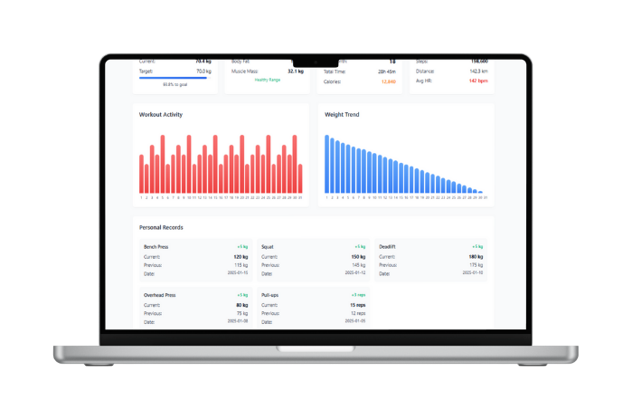
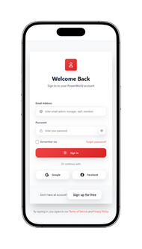
Gym Management
Suite
for
Power World Gym - Kiribathgoda
INTE 31356 - Software Development Project, Interim Product Presentation
IM/2022/001
A.M.K.C.S.B. Abeykoon

Slide 2

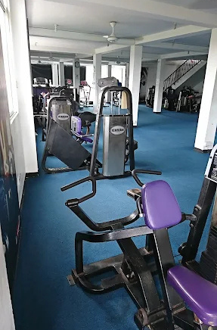
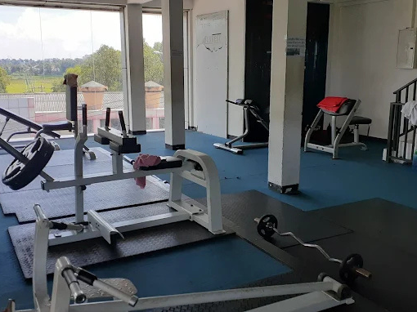
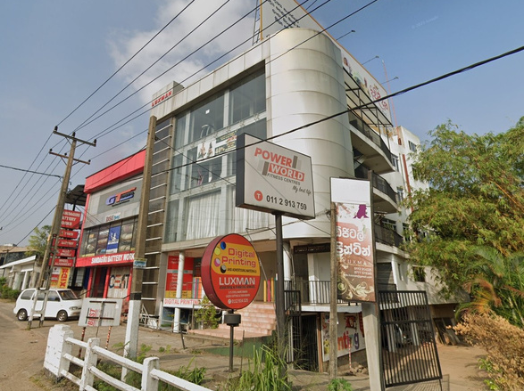

Business Overview
Name: Power World Gym
Address: No. 311,
Kandy Road,
Gala Junction,
Kiribathgoda
No. of Employees: 10
Working Hours: 5 a.m. - 10 p.m.
Monday - Saturday
Branch of the Power World fitness chain
Serves a diverse client base, from beginners to seasoned athletes, offering essential equipment and facilities.

Slide 3


Functional Requirements
Member identification through QR scanning.
Real-time subscription validation for access.
Automatic door access control for members.
Online membership purchase and renewal.
Secure payment processing integration.
Appointment booking and schedule management.
Workout progress tracking and reporting.
Administrative tools for data and report management.

Slide 4
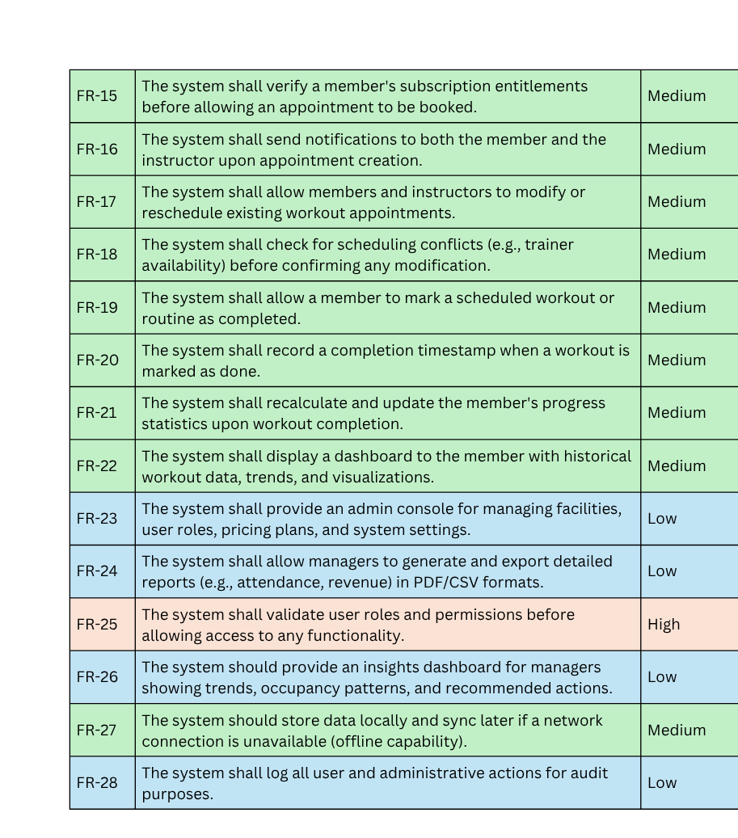
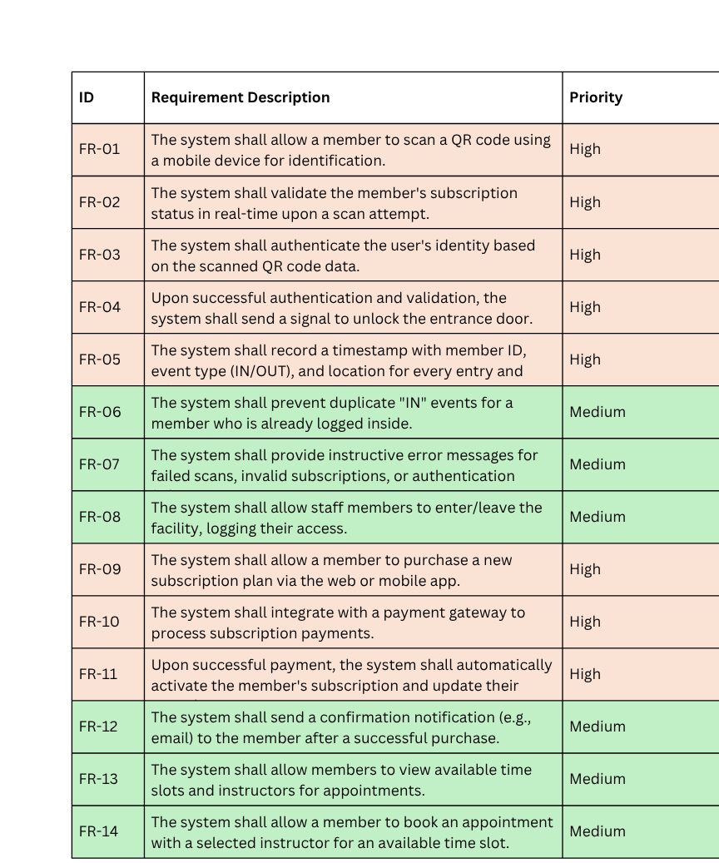
Functional Requirements

Slide 5

Non-functional Requirements
Secure QR-based member authentication process.
Reliable and fast access control operation.
Continuous system uptime during gym hours.
Safe online payment and data protection.
Simple and user-friendly mobile experience.
Scalable system for growing membership base.

Slide 6
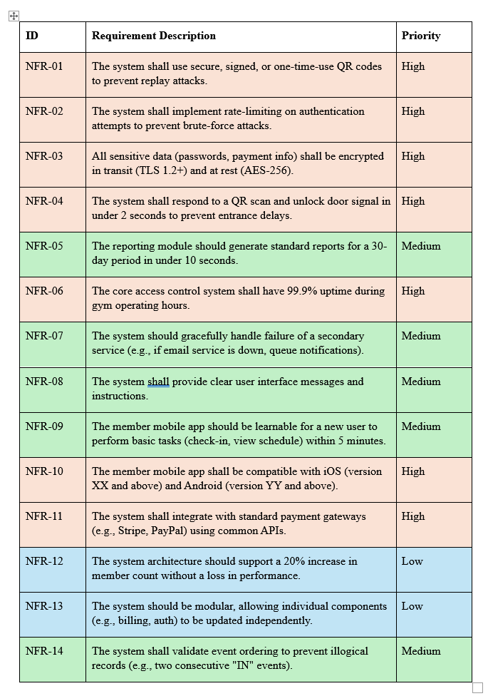
Non-Functional Requirements

Slide 7
Entity Relationship Diagram

Slide 8

UI Demonstration

Slide 9



